Slide 1

Heart Disease Prediction Analysis
Based on UCI Heart Disease Dataset
Capstone Two Modeling Case Story

Slide 2

Introduction
Objective: Predict presence and severity of heart disease using clinical features.
Dataset: UCI Heart Disease dataset (Cleveland subset).
Features: 13 clinical attributes (age, sex, cp, trestbps, chol, etc.).
Target: 'num' (0 = no disease, 1-4 = varying severity).

Slide 3
Data Preprocessing
Key steps taken to prepare the data:
Missing Value Handling: Identified in 'ca' and 'thal' features (Note: Imputation method not specified in notebook).
Feature Scaling: Min-Max scaling applied to normalize numerical features.
Categorical Encoding: Features like 'sex', 'cp', 'thal' converted using one-hot encoding.
Data Splitting: Dataset split into 80% training and 20% testing sets.

Slide 4
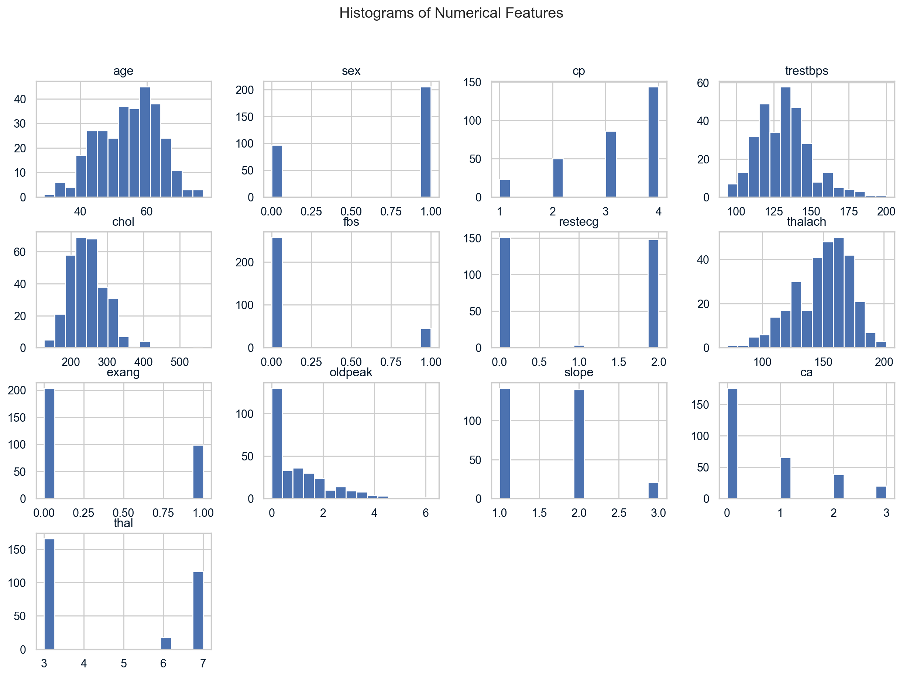
Exploratory Data Analysis (EDA) - Distributions
Histograms show the distribution of numerical features.

Slide 5
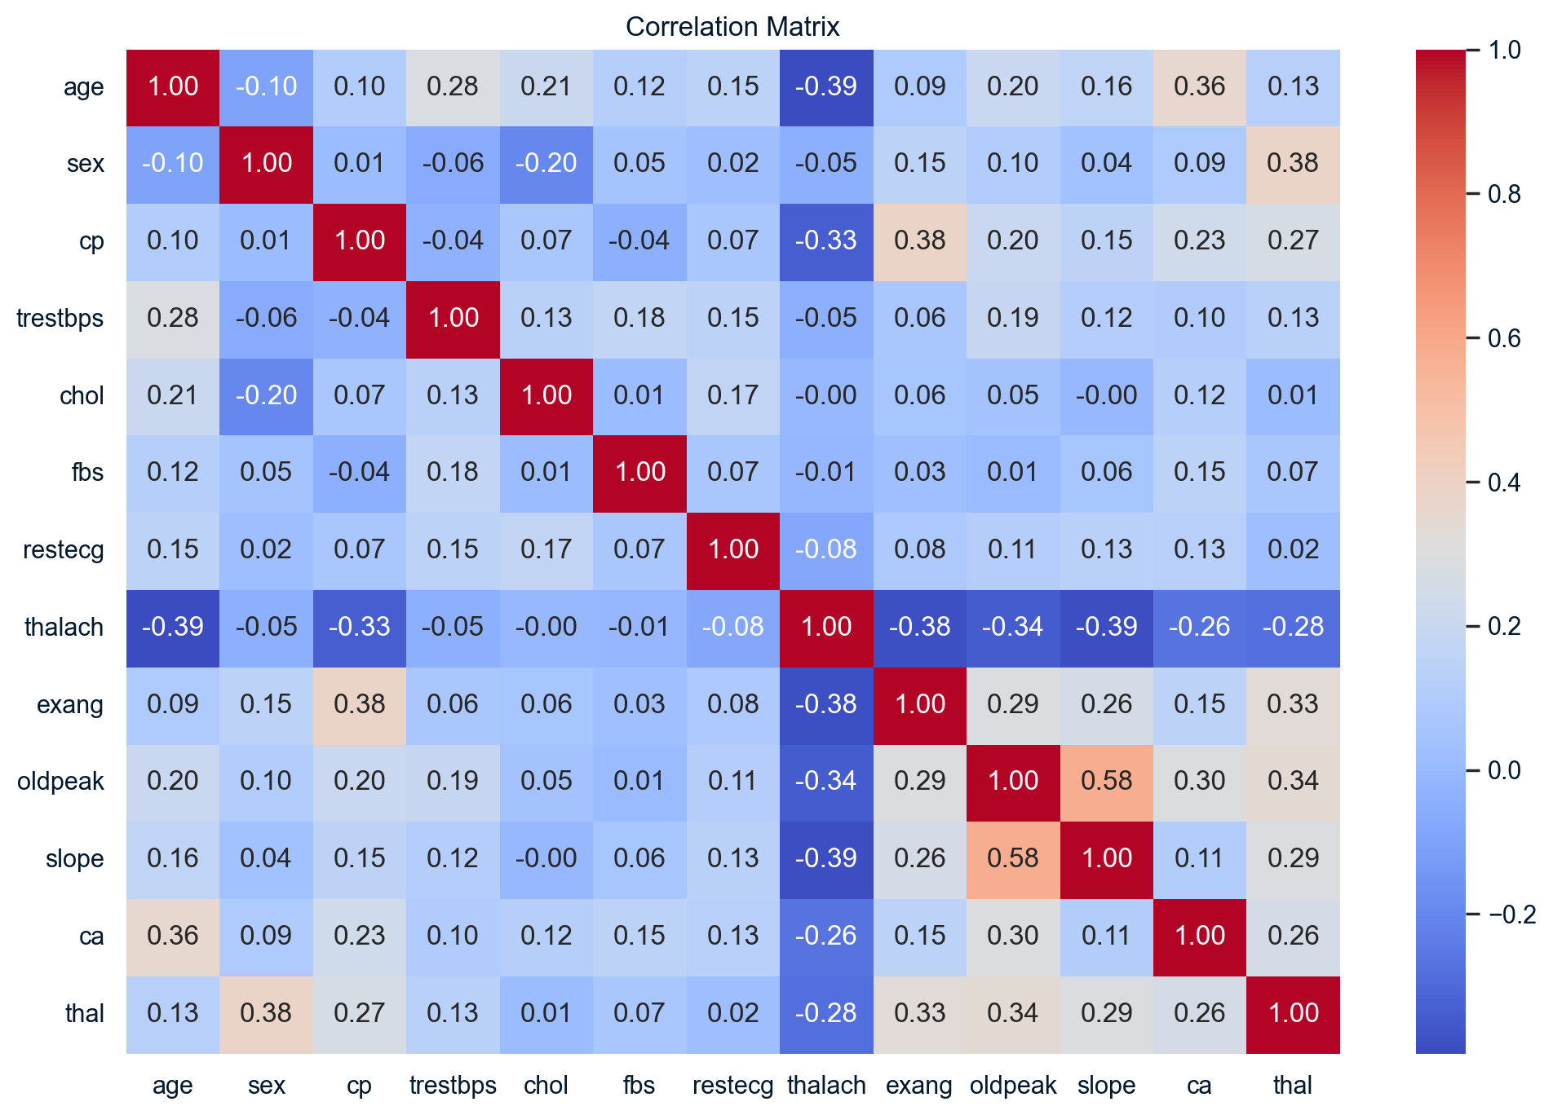
Exploratory Data Analysis (EDA) - Correlation
Correlation matrix heatmap reveals linear relationships between features.

Slide 6
Exploratory Data Analysis (EDA) - Pairplot
Pairplot visualizes pairwise relationships (subset shown due to size).

Slide 7
Modeling Approach
Three classification models were trained on the preprocessed training data:
Logistic Regression: Baseline linear model.
Random Forest Classifier: Ensemble tree-based model.
Support Vector Classifier (SVC): Model finding optimal separating hyperplane.

Slide 8
Model Performance Results
Accuracy on Test Set:
Logistic Regression: 54%
Random Forest: 49%
Support Vector Classifier (SVC): 54%
Key Observation from Classification Reports:
All models performed well predicting absence of disease (Class 0).
Poor performance (low precision/recall) for predicting presence/severity (Classes 1-4).

Slide 9
Conclusion & Next Steps
Best Performing Models (Accuracy): Logistic Regression & SVC (54%).
Limitation: Models struggle to distinguish between different levels of heart disease presence.
Potential Reasons: Class imbalance, need for better features or models.
Recommendations / Next Steps:
Address class imbalance (e.g., SMOTE).
Perform hyperparameter tuning.
Explore more advanced models or feature engineering.

